Slide 1
Apache Jena
Bc. Šimon Huraj

Slide 2
What is Apache Jena?
A free and open source Java framework for building Semantic Web and Linked Data applications.
Key Features:
  RDF/OWL modeling.
  SPARQL query engine.
  Reasoners for inference.
  Tools like TDB (storage) and Fuseki (SPARQL server).

Slide 3
Links
Base project
https://gitlab.science.upjs.sk/subjects/jenatutorial
RDF visualizer
https://www.ldf.fi/service/rdf-grapher

Slide 4
Introduction
How to create model?
How to print model?
How to serialize/deserialize model?
Exercise 1

Slide 5
Querying
getProperty – getSubject, getPredicate, getObject
listProperties
listStatements
Sparql API
Exercise 2

Slide 6
Inference
Reasoning extends knowledge by applying logical rules.
Types of Reasoners in Jena:
  Transitive reasoner: subPropertyOf, subclassOf
  RDFS Reasoner: configurable subset of the RDFS entailments
  OWL Reasoner: OWL Lite/DL semantics.
  Generic Rule Reasoner: Custom rules
Exercise 3

Slide 7
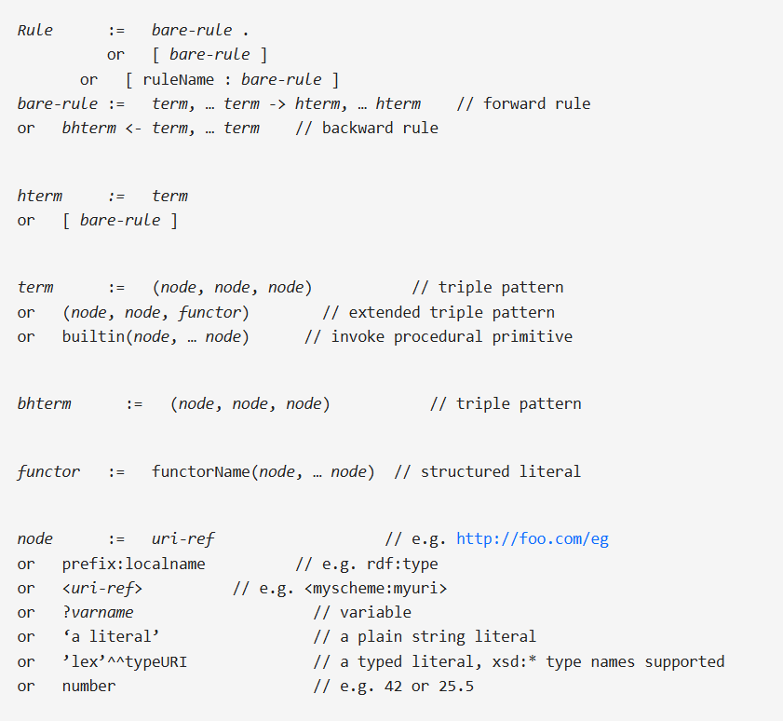

Slide 8
Thank you

